Slide 1
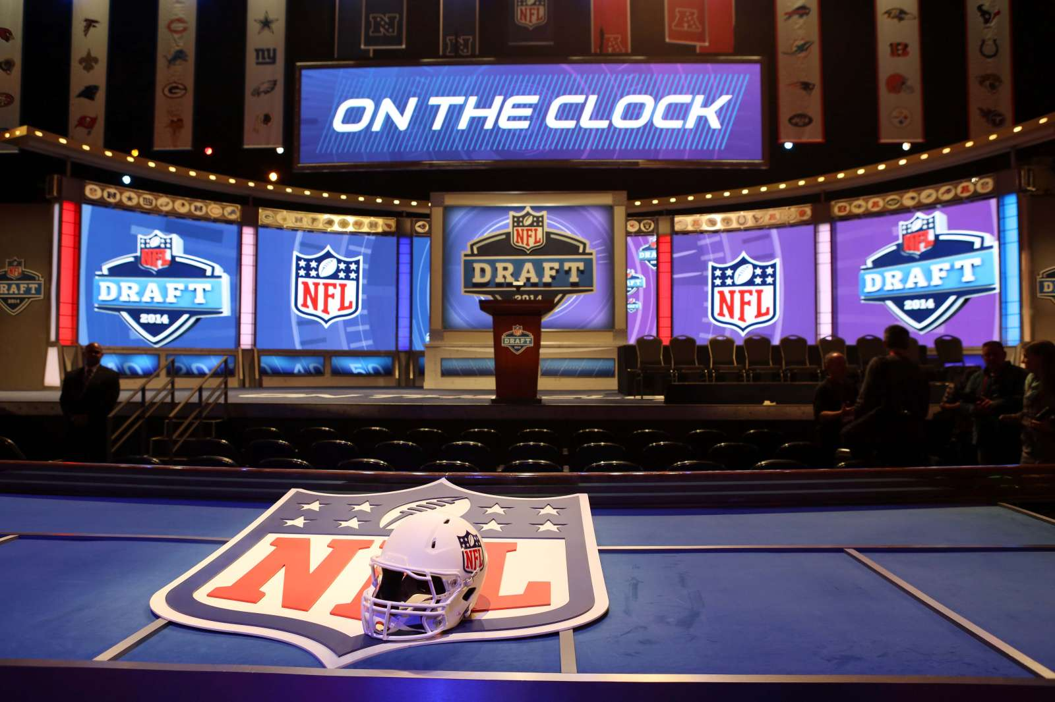
NFL Draft Prediction Project
Jacob Wang

Slide 2
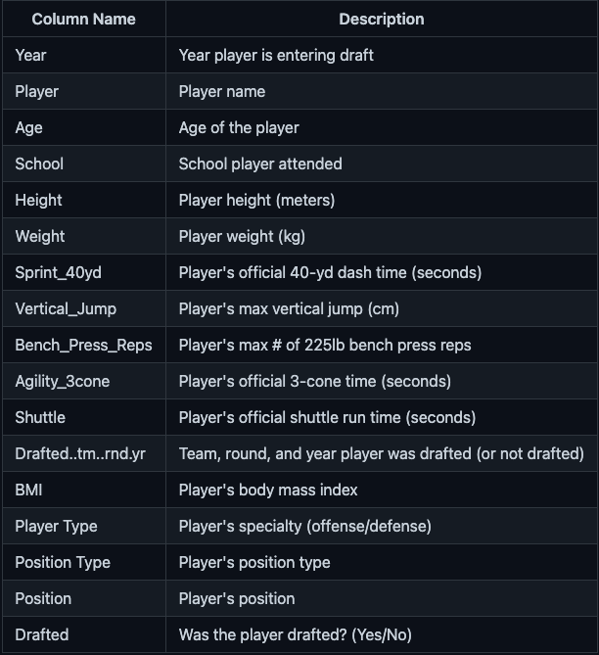
Dataset - NFL Combine Data from 2009-2019
To evaluate players the NFL hosts annual Draft Combine where players showcase their abilities
Goal: to build a model that can predict whether or not an NFL prospect will be drafted by a team. This prediction will be based primarily on player performance statistics from the NFL Draft Combine from the years 2009-2019. Other factors taken into account are age, BMI, height, and college attended.
Data was sourced from Kaggle via pro-football-reference.com

Slide 3
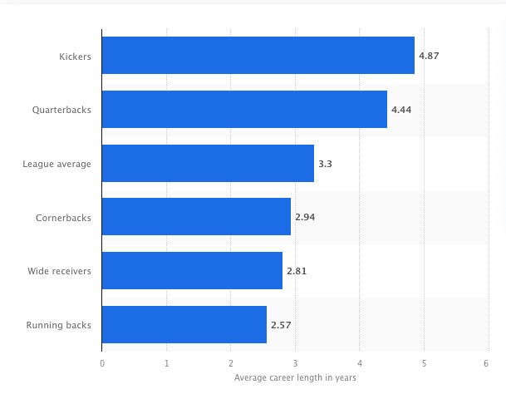
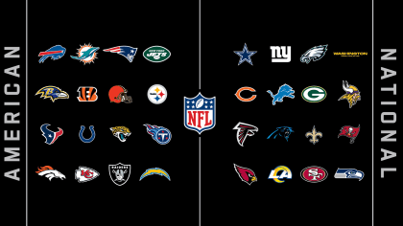
Stakeholder: All 32 NFL Teams
The National Football League holds a draft every year to add new talent to rosters
General Managers of NFL Teams are responsible for most draft decisions
Job security depends on good decisions
Drafting can be difficult, knowing which players to take is not always easy
Turnover extremely high
Avg career length - 3.3 years
Teams looking to improve draft results

Slide 4
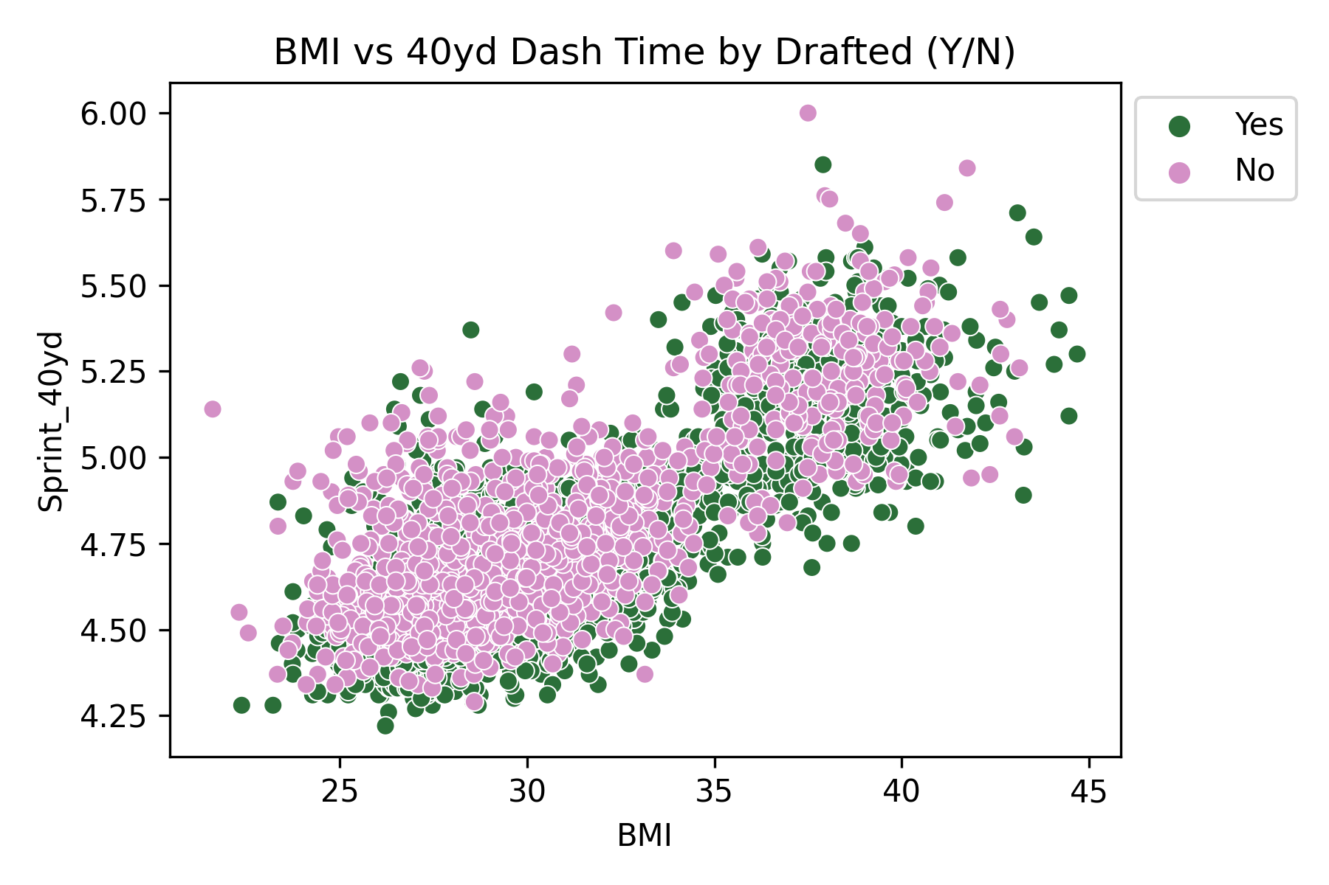
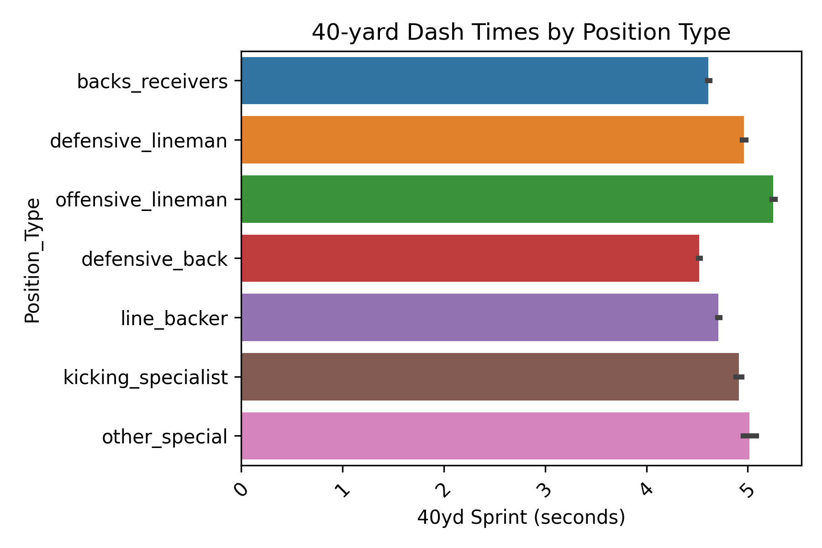
Results
Skill position players such as backs/receivers and defensive backs are on average, quicker than the rest of position types. Linebackers were the next quickest position type
Offensive and defensive linemen have the slowest times, as they typically weigh much more than other position types. Defensive linemen were significantly faster than offensive linemen.
Those with quicker times than others at their same BMI were drafted more often

Slide 5
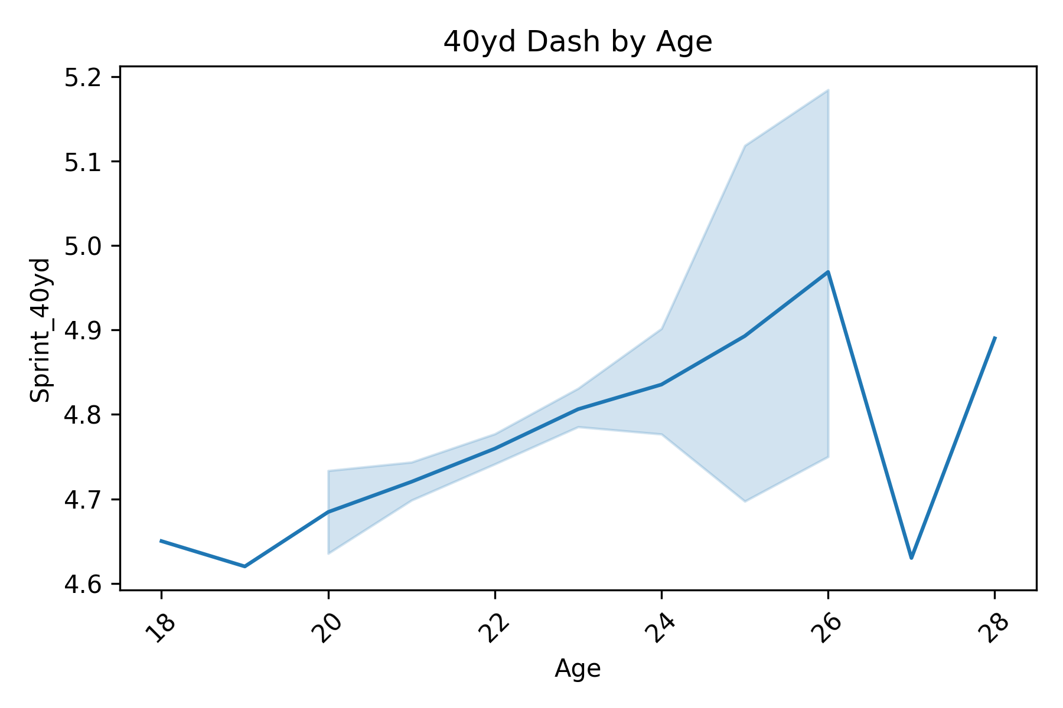
Results
Might be worthwhile to explore drafting younger players
Seems that players typically will become slower as they age

Slide 6
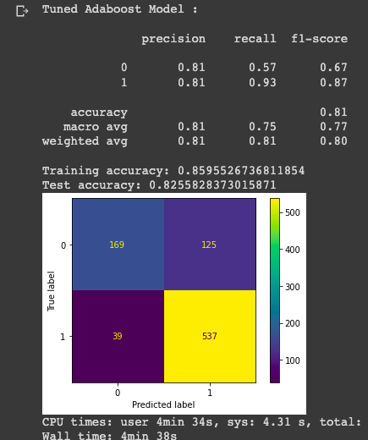
Final Model:
When drafting players it is very important to minimize false positives (bad draft picks) due to the time/resources it will cost should the player ultimately not make an impact for a team
Missing out on good draft picks (incurring false negatives) is almost equally as important to avoid
Not only will you lose a good player, an opponent will gain a good player
Final production model excelled at minimizing false positives and maximizing good draft picks relative to others

Slide 7
Strengths & Limitations
Model still had a somewhat high amount of false positives (possible bad draft picks)
However, the model excelled at limiting false negatives (missed good draft picks)
Model correctly predicted roughly 87% (f1-score)
Model only takes into account physical performance
Cannot take into account intangibles
Only took around 1+ hour to run

Slide 8
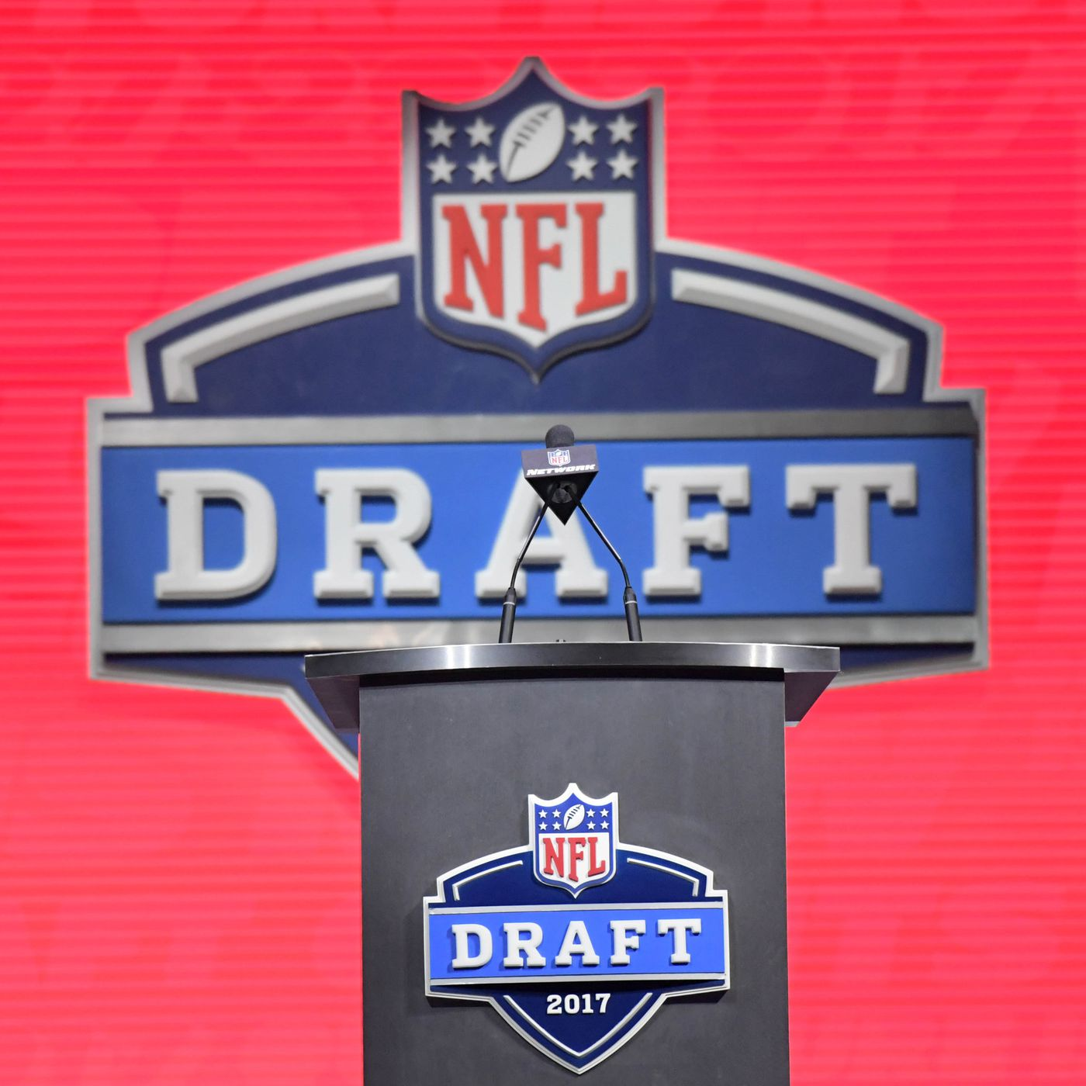
Final Recommendations
Model can severely reduce amount of time needed to evaluate draft picks
Cannot take into factor important intangibles (performance in college, personality, etc.)
Good measure of physical ability, whether or not most teams would/would not draft player
False positives still prevalent → additional vetting is needed

